Slide 1
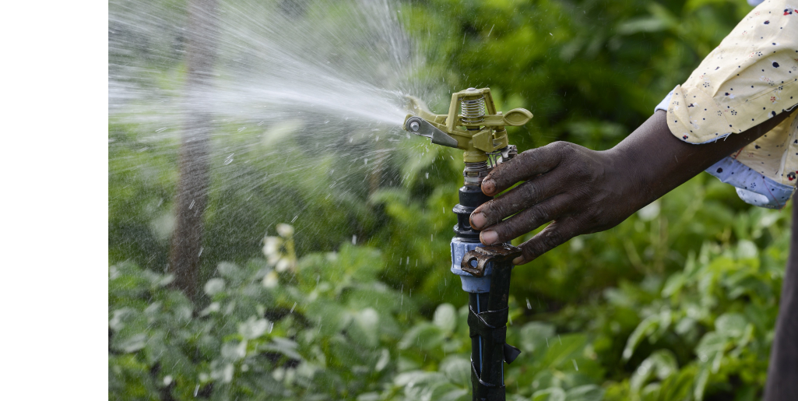
SPIS Training
WEBINAR IV – Irrigation / Soil Tool

Slide 2
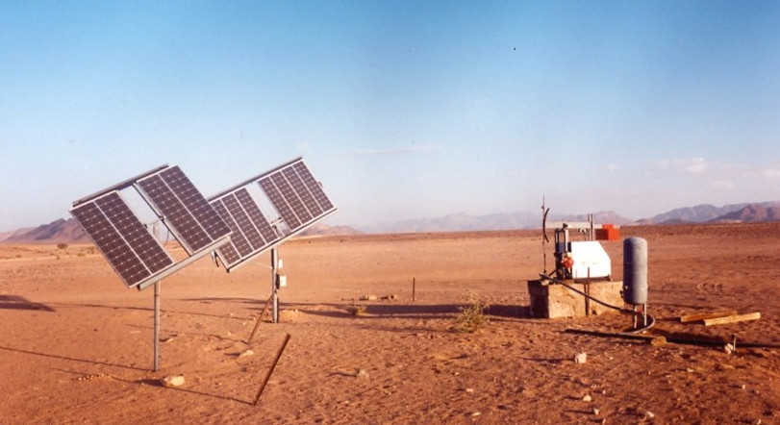
Welcome
to the Webinar Series on SPIS
brought to you by
Water and Energy for Food WE4F
developed by Margraf Publishers on the basis of the «Energypedia Toolbox»
Notes:
Good afternoon and Welcome to our Webinar Series on Solar Powered Irrigation Systems (SPIS) for trainers. It presents the most important tools to design and operate pumping systems and irrigation equipment that utilize solar energy, and to assess whether solar powered irrigation is feasible and applicable in different contexts.
The emphasis is on collaboration between you as participants and between participants and trainers. We will try to make the webinars as lively as possible, although we are aware that a face-to-face workshop is certainly a better solution. Nevertheless, we try to use a lot of collaborative instruments such as polls and working groups, discussion forums, question and answer possibilities, etc.
Naturally, you as participants will be able to widen your background of solar powered small-scale irrigation, which will not come only from the trainers but also from your fellow participants. We will therefore try to involve you as well as presenters in the webinars so that at least some of you will have the opportunity to present specific aspects of your work in SPIS.
A few words on SPIS:
Irrigation is among the measures that can improve yields, reduce vulnerability to changing rainfall patterns, and enable multiple cropping practices. Although expanding, land area under irrigation nevertheless represents a marginal share of total cultivated area, especially in sub-Saharan Africa, where only 5% of farmland is irrigated. Affordable, reliable and environmentally sustainable energy is a vital input for delivering irrigation services.
Solar-powered water technologies are increasingly in demand, as they can provide a cost-effective solution to increase agricultural productivity. Access to water for irrigation is key to many small- scale farmers in order to sustain their livelihoods and food security. Running such irrigation systems is still extremely challenging. In the absence of a reliable electricity supply, farmers often resort to diesel-based pumping systems. These systems create high operating costs, often experience service gaps, contribute to greenhouse gas emissions, and contribute to the energy bill in countries that do not produce such fuels.
Renewable energy options, and in particular solar power, seem a very promising solution for sustainable small- scale agriculture in regions with high solar insulation like Eastern Africa, given its environmental advantages, low maintenance, and decreasing investment costs. However, knowledge of the technology itself, its feasibility, appropriateness and potential for up-scaling is often lacking.
However, we also must be aware that there are also risks with SPIS, especially if we look at the water balance in a watershed and see the risk of groundwater overuse. Therefore, we always have to see the advantages but as well the risks associated – the webinars want to make you aware of the risks as well.
You as participants, we encourage you to actively engage in discussions and contribute with your own experiences and knowledge on solar technology and initiatives in your respective countries. Our experience is that the exchange between you participants of different countries is often the highlight of such webinars.

Slide 3
Introduction to the Webinar-series
In a sequence of six webinars of 1:45 hrs each, you will be familiarised with the use of the most important Excel tools in the SPIS-Toolbox
At the end of the six webinars, you should be able to advise farmers on the use of SPIS for agricultural irrigation
The training material consists of the agenda and corresponding resources (videos, additional documents, test questions)
Notes:
The webinars are designed for extensionists, policy makers financiers, not so much for end-users (farmers).
Timing:
It is important to make participants aware that you always start 15 min before in order to support them when problems with the webinar software and to (hopefully) solve internet access problems (if possible)
All Webinars will last at the core 105 min and start with an explanation of the respective tool and foresee 15 min at the end for one of the participants to share experiences in SPIS
The agenda will be shown in the next slide – the basic structure will be similar for all the 6 webinars.

Slide 4
Agenda Webinar IV – The complexities of Irrigation add time and date here
Time | Topic | Remark
23:45 | Room is open | Insert the address here
00:00 | Welcome | Introduction to the topic
00:05 | Today’s objectives | Who is online? Where do the participants stand? Program & Objectives
00:10 | Homework of Webinar III | Solutions and Discussion «Pump Sizing»
00:35 | Poll | Are there burning questions?
00:40 | Icebreaker | Decide on an icebreaker game
00:50 | Toolbox: The Soil Tool
01:00 | Group work
01:20 | Homework
01:30 | Presentation of a SPIS project | Insert the topic and the name of the participant (s) here (as agreed on during the last webinar)
01:45 | Farewell & Outlook | Evaluation, next presentation
Notes:
Adjust the times, links, presentation names (all what is written in red)
Who is online – you can ask the participants perhaps what was important for them since the last webinar; what occupied them, how they feel in general (or similar)
We will shortly discuss the home work – we are happy that many of the participants have sent in their results and mostly the correct ones. In this webinar.
After a poll and an icebreaker, we will go to the soil tool today, which gives you information about the irrigation schedule. We will work in groups to understand the tool better.
We will explain the homework which asks questions about the soil tool.
We are happy to have the participant...., who will talk to us on.....
Farewell: Summarise the results of the evaluation of webinar III and announce the evaluation of Webinar IV; Determine a participant you will present next

Slide 5
General Objectives
Relevant background information on the components of Solar Powered Irrigation Systems and plan their application
Emphasis will be on the use of the most important Excel tools in the SPIS-toolbox
Hands-on guidance to end-users, but also policy makers and financiers
Notes:
Highlight that today we will focus on Irrigation and Soil, and introduce the soil tool

Slide 6
Objectives of Webinar IV
Participants are familiar with different types of soil
They know more about the irrigation schedule for various crops depending on soil, climate and irrigation method
Participants are familiar with the Soil tool and know how to use it

Slide 7
Who is online?
Please tell us very briefly (in not more than 30 sec)
What was important for you in the last webinar
What happened since the last meeting
Notes:
Make sure that people do not talk more than 30 sec as we will otherwise run out of time. (Calculate the necessary time – possibly adapt the agenda)
Because of time constraints, you may only ask 3 persons who volunteer, or you ask them directly!
Maybe the trainer starts with presenting him/herself – this will set the scene and participants have a short guideline of how to do it.

Slide 8
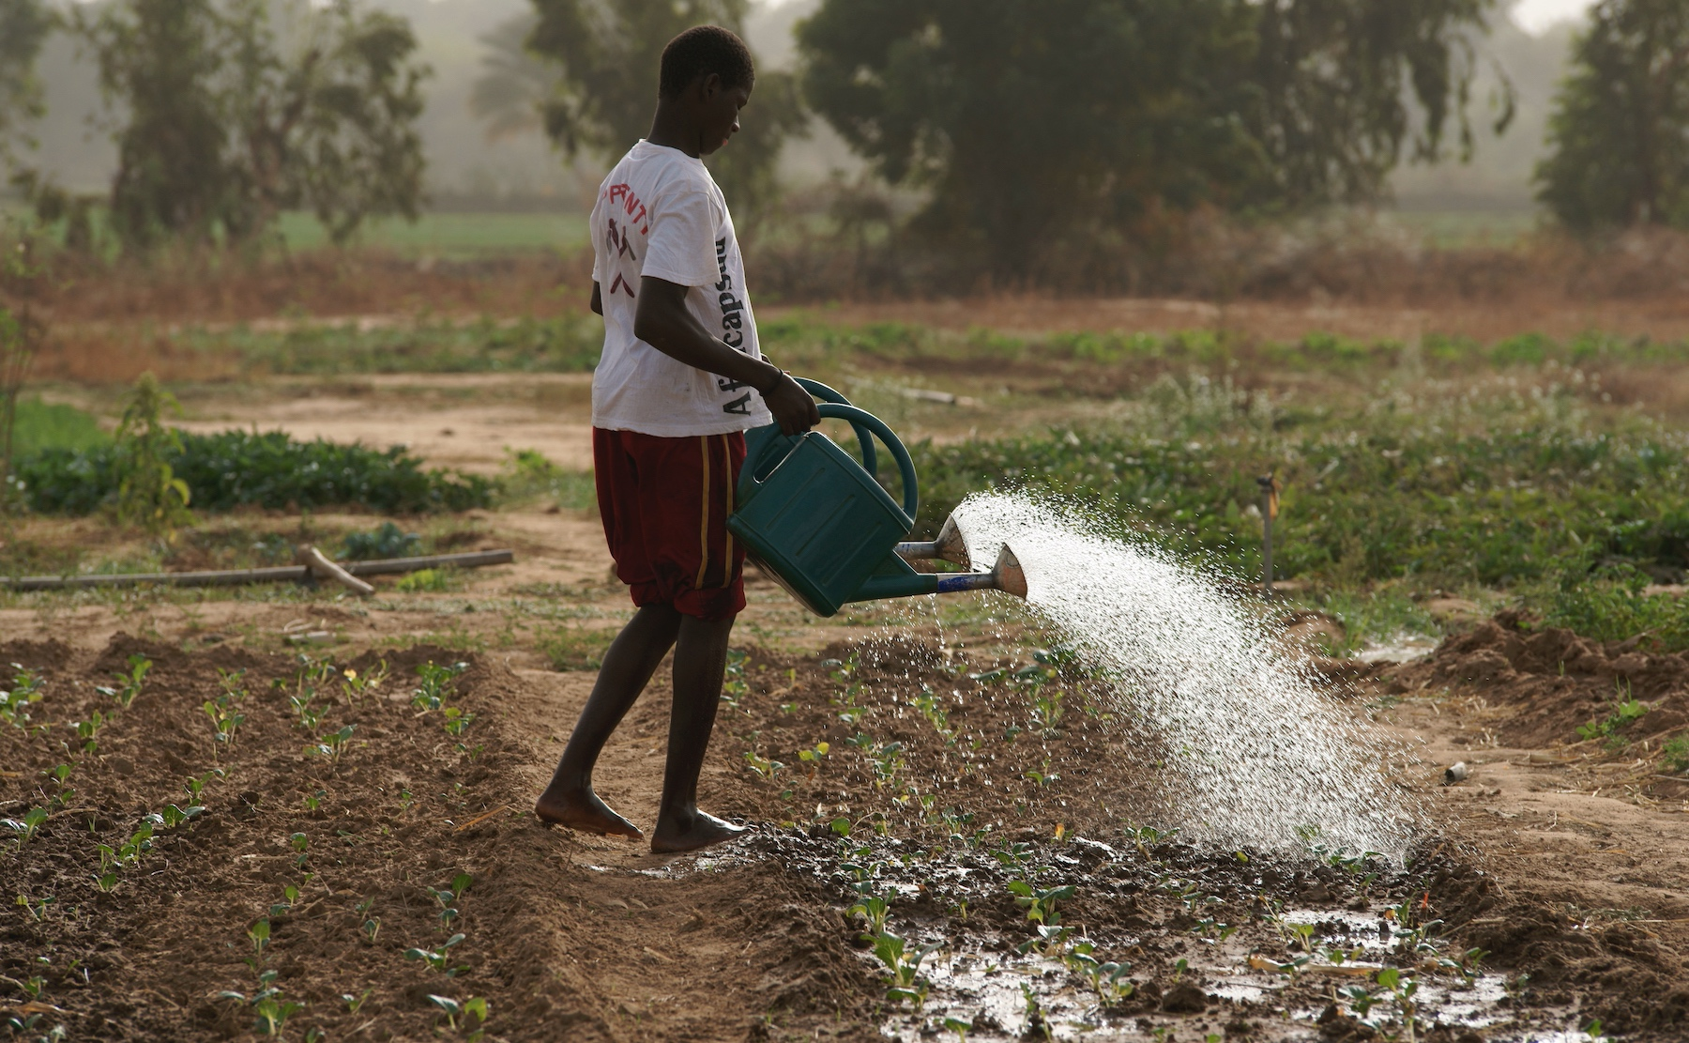

Slide 9
Homework III
Notes:
What is the Total Dynamic Head of the pumping system? 50 m
Which is the lowest power (kWp) required (solar deration losses of 25 %)? 2,1 kWp
How big is the surface of solar panels to be installed? 14 m² - 19 m²
From a neighbor who changed the water system, Mary could get PVP-tubes of 1” for free. Should she accept this friendly offer? No; system becomes more expensive

Slide 10
Homework III – Solution
What is the Total Dynamic Head of the pumping system? 50 m
Which is the lowest power (kWp) required (solar deration losses of 25 %)? 2,1 kWp
How big is the surface of solar panels to be installed? 14 m² - 19 m²
From a neighbor who changed the water system, Mary could get PVP-tubes of 1” for free. Should she accept this friendly offer? No; system becomes more expensive
Notes:
Here are the results of how the figures for your homework should look like. The figures should come from the sheet Output_Results of the Pump Sizing Tool -
...discuss the common mistakes and show the correct process of filling in data, etc. depending on the mistakes

Slide 11
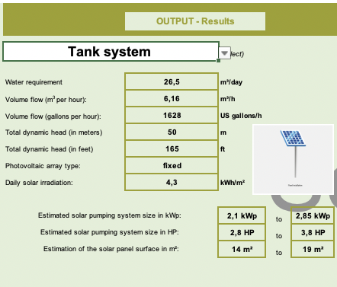
Homework III
Notes:
Prepare the correct Results sheet of the Pump Sizing Tool

Slide 12
Poll 1: Any burning questions on pumps & pump sizing?
Understood so far – please go ahead
Yes, there are some questions
Notes:
Single choice
You may use a poll system depending on the platform you use:
Zoom: Polls are integrated into the platform – you can prepare the questions in advance
MS TEAMS (GIZ version): If MS Teams is provided by GIZ, polls are not available. You must either use a external tool (SliDo) or provide the question as a hand-out (prepare in advance) and ask participants to print, mark their choice and hold it into the camera.
Ask participant s to give their answers in the Chat
Participants are now familiar with the webinar tool and can be given the right to speak and ask questions and an experienced person (of the trainer team) must be available to answer.
Offer them additional resources
Refer to the possibility of collecting written questions which can be answered separately in one of the next webinars or as an e-mail to all participants (create a group in your e-mail client)

Slide 13
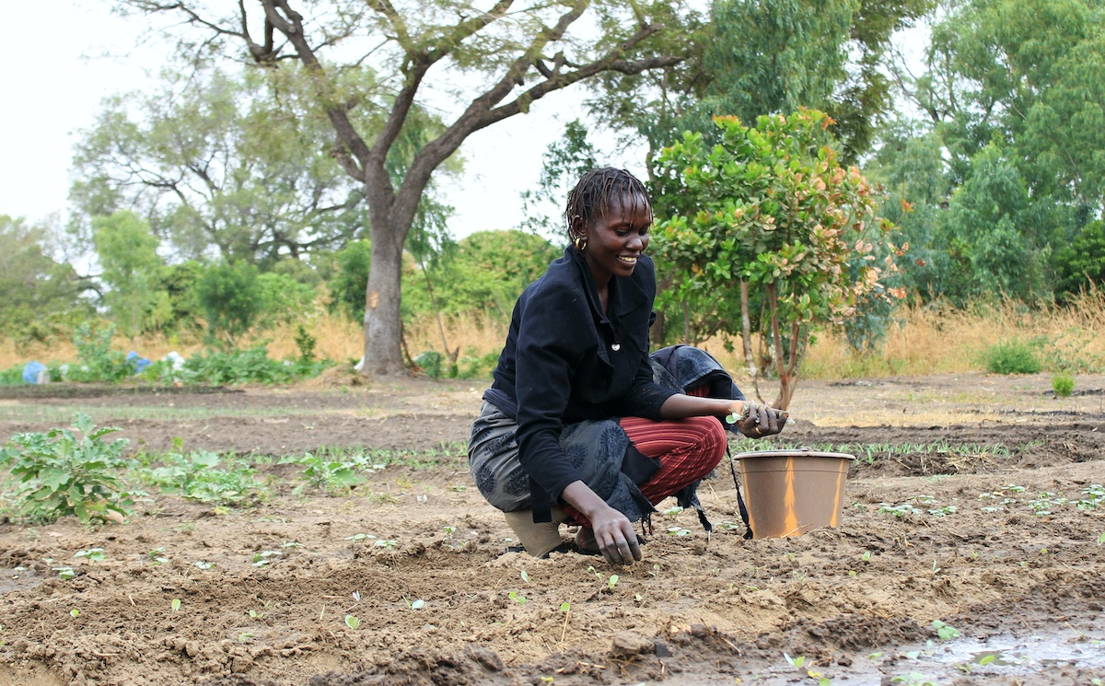

Slide 14
Ice-Breaker
Icebreaker game
Notes:
Refer to PODIO for examples on ice-breaker games
You may use the exercise (Handout 4.7) by Khaled of the Hall of shame focused on irrigation

Slide 15
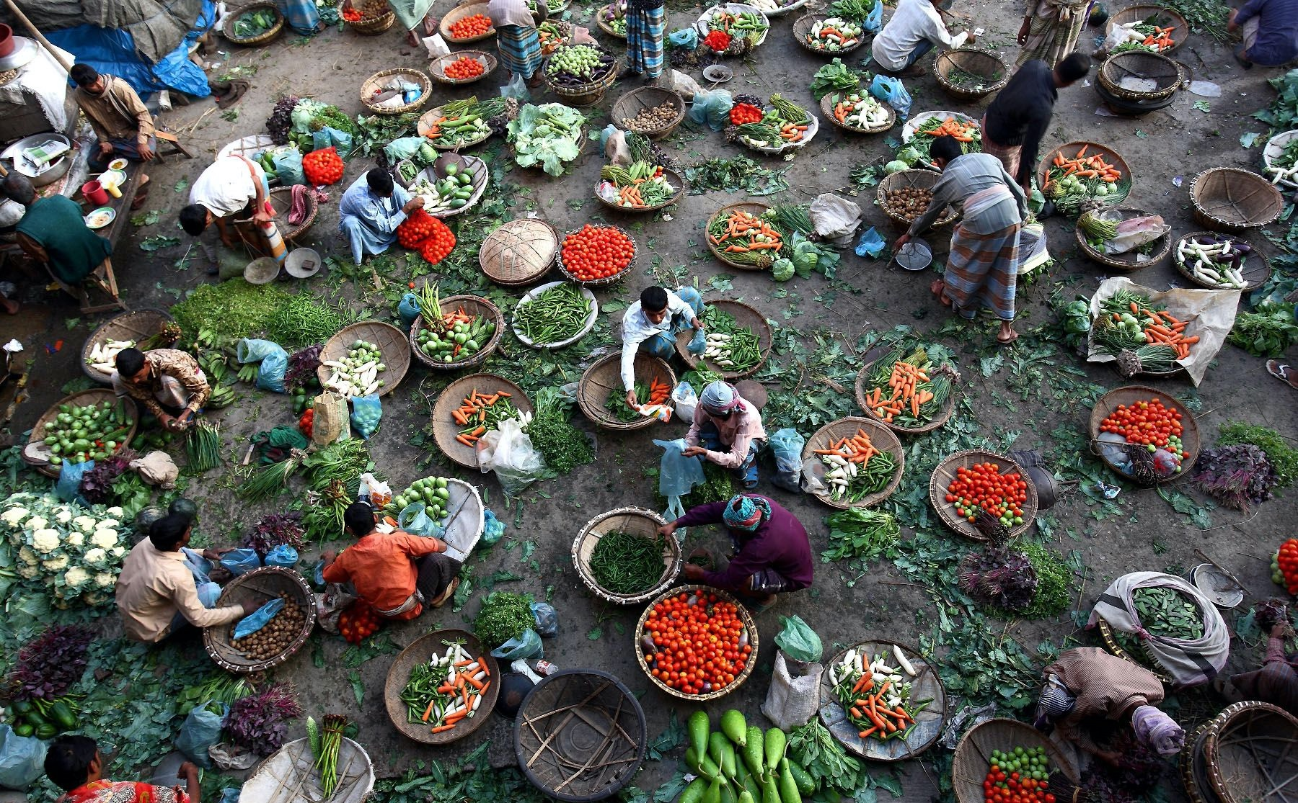

Slide 16
The toolbox – an overview
The «Energypedia toolbox» is the basis for the webinars and we will mainly concentrate on the tools to plan and design SPIS.
Let us look at the toolbox: https://energypedia.info/wiki/Toolbox_on_SPIS
Show the website (link above), go to “Contents of the Toolbox” and then to Irrigate and download the “Soil Tool” (Handout4.1)
Notes:
Introducing the Soil Tool by some general information on Soil can be a good idea.
Handout 4.6 by Khaled explains it very well!
It could be followed by Handout 4.5 by Kahled – an exercise about the different irrigation types.

Slide 17
CCC Kenya & Soil Tool
2 Hand-Outs: 4.1 & 4.2
CCC: The farm of Miss Mary Wanjiku in Kenya
The Soil Tool complements the Water Requirement Tool by determining a suitable irrigation schedule according to crop and soil type.
Refer to the screencast
Notes:
https://youtu.be/ox7u-CQHRAw Screencast

Slide 18
Group work
Hand-Out: 4.1 & 4.2
What is the shortest frequency Mary needs to irrigate the tomatoes? Use the Soil Tool (Data pre-filled are not for the CCC Kenya) Groups have 4-5 members and we have them already pre-selected:
Group 1…
Notes:
Prepare x groups with 4 to 5 members and put into the rooms: (For group work refer to the previous webinars)
Handout 4.1_Soil_Tool (the data in the tool are only to show how to fill them in – they do not apply to the CCC Kenya)
Handout 4.2_Country_Case_Card_Kenya_m2; the task for the group can be seen in red!
Explain – the soil tool has been changed to adapt better to farmers‘ needs.
We need 2 more values to complete the task, i.e.
The initial water content TAW, which is 100% when planting, as you plant into a well watered soil and
The irrigation depth, which we assume of 10 mm for drip irrigation (see also table at the very right of the Excel sheet „Irrigation schedule“)

Slide 19
Group work: Presentation of results
Presenter Group 1
Presenter Group 2
….
Notes:
Ask which group wants to present. Make sure that the group results can be shown and one person of the group gets the right to talk (microphone unmuted) and that the screen can be shared

Slide 20
Videos
Hand-Out: 4.3
Please watch:
«Hands-On Video» - How Drip Irrigation works:
«Hands-On Video» – How Irrigation with Mini/Micro Sprinklers work
Notes:
https://youtu.be/71SIxkaHzLM (Drip Irrigation)
https://youtu.be/69eHRbnUKrc (Sprinklers)

Slide 21
Homework
2 Hand-Outs: 4.1 & 4.2.
Make yourself familiar with CCC Kenya questions on irrigation (Soil Tool) and send filled out sheet 4: «Summary» of the «Soil Tool» (Data in the tool for demonstration only and do not apply to CCC Kenya).
Additional information: TAW = 100%
Irrigation depth = 10 mm (drip irrigation)
Watch the hands-on videos (see previous slide)
Refer to the screencast
Please fill in the evaluation in «Google Forms» (add the address here)
Notes:
As before, all you need to do is to send to us (: give address or other places where to send) the sheet 4, Summary of the „Soil Tool“
There is a good video that helps you to fill out the sheets if you encounter problems.
The handout 4.1 is the soil tool and Handout 4.2 is again the Country Case Card Kenya and the question in red is the one to be answered.
Remember the participants:
The soil tool has been changed to adapt better to farmers‘ needs.
You need 2 more values to complete the task, i.e.
The initial water content TAW, which is 100% when planting, as you plant into a well watered soil and
The irrigation depth, which we assume of 10 mm for drip irrigation (see also table at the very right of the Excel sheet „Irrigation schedule“)
You may want to work in groups – in the ones you stayed earlier on or you select your co-works otherwise.
The handout 4.3 gives you links to the screencast, but as well hands-on videos to different irrigation methods.
Prepare in advance the evaluation questions in Google forms. Examples for questions can be:
Name of the Webinar
Name/e-mail (voluntary?)
Skill and responsiveness of the trainer
Did the level of the course meet my knowledge?
What aspects of this course were most useful or valuable?
Course content was relevant for my work
How would you improve this course?
What can be done better next time?

Slide 22
Presentation
Short presentation of a SPIS project by a participant
Notes:
As always, if the responsible trainer for this webinar has an own presentation, it might even be better

Slide 23
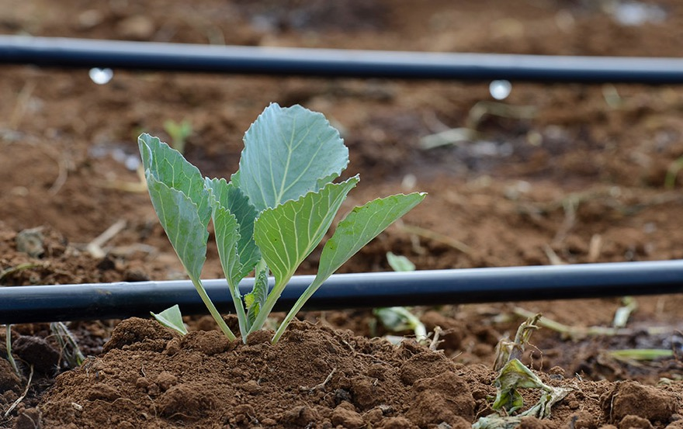

Slide 24
WATER & ENERGY FOR FOOD

