Slide 1
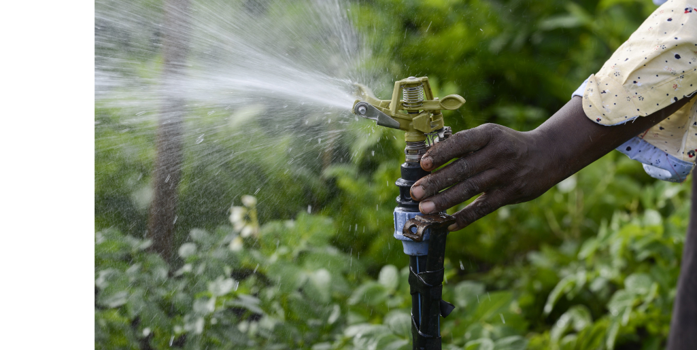
SPIS Training
WEBINAR III – Pump Sizing

Slide 2
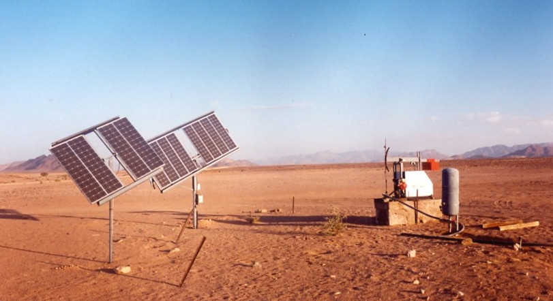
Welcome
to the Webinar Series on SPIS
brought to you by
Water and Energy for Food WE4F
developed by Margraf Publishers on the basis of the «Energypedia Toolbox»
Notes:
Good afternoon and Welcome to our Webinar Series on Solar Powered Irrigation Systems (SPIS) for trainers. It presents the most important tools to design and operate pumping systems and irrigation equipment that utilize solar energy, and to assess whether solar powered irrigation is feasible and applicable in different contexts.
The emphasis is on collaboration between you as participants and between participants and trainers. We will try to make the webinars as lively as possible, although we are aware that a face-to-face workshop is certainly a better solution. Nevertheless, we try to use a lot of collaborative instruments such as polls and working groups, discussion forums, question and answer possibilities, etc.
Naturally, you as participants will be able to widen your background of solar powered small-scale irrigation, which will not come only from the trainers but also from your fellow participants. We will therefore try to involve you as well as presenters in the webinars so that at least some of you will have the opportunity to present specific aspects of your work in SPIS.
A few words on SPIS:
Irrigation is among the measures that can improve yields, reduce vulnerability to changing rainfall patterns, and enable multiple cropping practices. Although expanding, land area under irrigation nevertheless represents a marginal share of total cultivated area, especially in sub-Saharan Africa, where only 5% of farmland is irrigated. Affordable, reliable and environmentally sustainable energy is a vital input for delivering irrigation services.
Solar-powered water technologies are increasingly in demand, as they can provide a cost-effective solution to increase agricultural productivity. Access to water for irrigation is key to many small- scale farmers in order to sustain their livelihoods and food security. Running such irrigation systems is still extremely challenging. In the absence of a reliable electricity supply, farmers often resort to diesel-based pumping systems. These systems create high operating costs, often experience service gaps, contribute to greenhouse gas emissions, and contribute to the energy bill in countries that do not produce such fuels.
Renewable energy options, and in particular solar power, seem a very promising solution for sustainable small- scale agriculture in regions with high solar insulation like Eastern Africa, given its environmental advantages, low maintenance, and decreasing investment costs. However, knowledge of the technology itself, its feasibility, appropriateness and potential for up-scaling is often lacking.
However, we also must be aware that there are also risks with SPIS, especially if we look at the water balance in a watershed and see the risk of groundwater overuse. Therefore, we always have to see the advantages but as well the risks associated – the webinars want to make you aware of the risks as well.
You as participants, we encourage you to actively engage in discussions and contribute with your own experiences and knowledge on solar technology and initiatives in your respective countries. Our experience is that the exchange between you participants of different countries is often the highlight of such webinars.

Slide 3
Introduction to the Webinar-series
In a sequence of six webinars of 1:45 hrs each, you will be familiarised with the use of the most important Excel tools in the SPIS-Toolbox
At the end of the six webinars, you should be able to advise farmers on the use of SPIS for agricultural irrigation
The training material consists of the agenda and corresponding resources (videos, additional documents, test questions)
Notes:
The webinars are designed for extensionists, policy makers financiers, not so much for end-users (farmers).
Timing:
It is important to make participants aware that you always start 15 min before in order to support them when problems with the webinar software and to (hopefully) solve internet access problems (if possible)
All Webinars will last at the core 105 min and start with an explanation of the respective tool and foresee 15 min at the end for one of the participants to share experiences in SPIS
The agenda will be shown in the next slide – the basic structure will be similar for all the 6 webinars.

Slide 4
Agenda Webinar III – Pump Sizing add time and date here
Time | Topic | Remark
23:45 | Room is open | Insert the address here
00:00 | Welcome | Introduction to the topic
00:05 | Today’s objectives | Who is online? Where do the participants stand? Program & Objectives
00:10 | Homework of Webinar II | Solutions and Discussion «Water Requirement»
00:30 | Poll | What is your opinion on the course?
00:35 | Icebreaker | Decide on an icebreaker game
00:45 | Introduction to pumps | Presentation based on Lorentz with test questions
01:00 | Centrifugal pumps
01:10 | Toolbox: The Pump Sizing Tool
01:20 | Homework
01:30 | Presentation of a SPIS project | Insert the topic and the name of the participant (s) here (as agreed on during the last webinar)
01:45 | Farewell & Outlook | Evaluation, next presentation
Notes:
Adjust the times, links, presentation names (all what is written in red)
Who is online – After we already received a short introduction last webinar, you can ask the participants perhaps what was important for them since the last webinar; what occupied them, how they feel in general (or similar) The first point has already been done and we are happy that the Webinar Tool is now understood by all.
We will shortly discuss the home work – we are happy that many of the participants have sent in their results and mostly the correct ones.
After a poll and an icebreaker, we will do an introduction to pumps. And then go to pump sizing, one of the most important aspects in SPIS.
We will go through the pump sizing tool together, as it is quite comprehensive and covers many different aspects, important for the sizing of pumps.
We will explain the homework which asks questions on pump sizing. Each webinar will give you a short homework, You will work on one tool (in our case the Pump Sizing Tool) in order to understand it and be able to discuss about it in the next Webinar.
We are happy to have the participant...., who will talk to us on.....
Farewell: Resume the results of the evaluation of webinar II and announce the evaluation of Webinar III; Determine a participant you will present next

Slide 5
General Objectives
Relevant background information on the components of Solar Powered Irrigation Systems and plan their application
Emphasis will be on the use of the most important Excel tools in the SPIS-toolbox
Hands-on guidance to end-users, but also policy makers and financiers
Notes:
Highlight that today we will focus on Pumps and the Pumps sizing tool

Slide 6
Objectives of Webinar III
Participants know the characteristics of different types of pumps and how they work, emphasis on centrifugal pumps.
Participants are familiar with the Pump Sizing Tool and how to use it to determine pump type and size.

Slide 7
Who is online?
Please tell us very briefly (in not more than 30 sec)
What was important for you in the last webinar
What happened since the last meeting
Notes:
Make sure that people do not talk more than 30 sec as we will otherwise run out of time. (Calculate the necessary time – possibly adapt the agenda).
Because of time constraints, you may only ask 3 persons who volunteer or you ask them directly!
Maybe the trainer starts with presenting him/herself – this will set the scene and participants have a short guideline of how to do it.

Slide 8
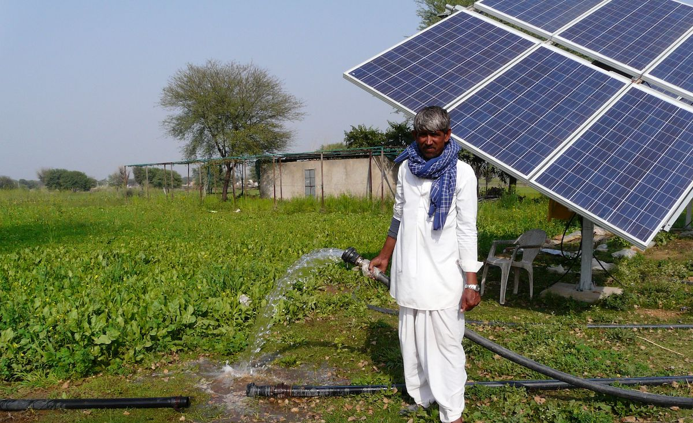

Slide 9
Homework II
Notes:
Only one growing season, starting in March (flood irrigation):
In which month is the highest irrigation water need? June
What is the total highest daily irrigation water need? 30,7 m3
With a second growing period with planting in September (flood irrigation) :
In which month is the highest irrigation water need? June
What is the total highest daily irrigation water need? 30,7 m3
What is the highest daily water pumping need, for the two growing periods (if she would use micro sprinkler irrigation) and for her dairy cows?26.3 and 0.5 m3
What is the pump utilisation rate when having one or two growing periods under micro sprinkler? 24% for one period, 54% for two

Slide 10
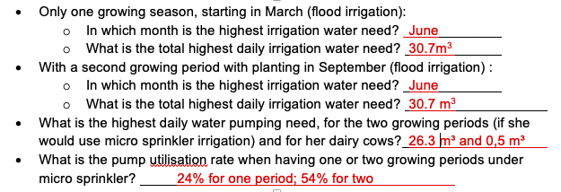
Homework II – Solution
Notes:
Here are the results of how the figures for your homework should look like. The figures should come from the sheet 4 Summary of the Water Requirement Tool
...discuss the common mistakes and show the correct proces of filling in data, etc. depending on the mistakes

Slide 11
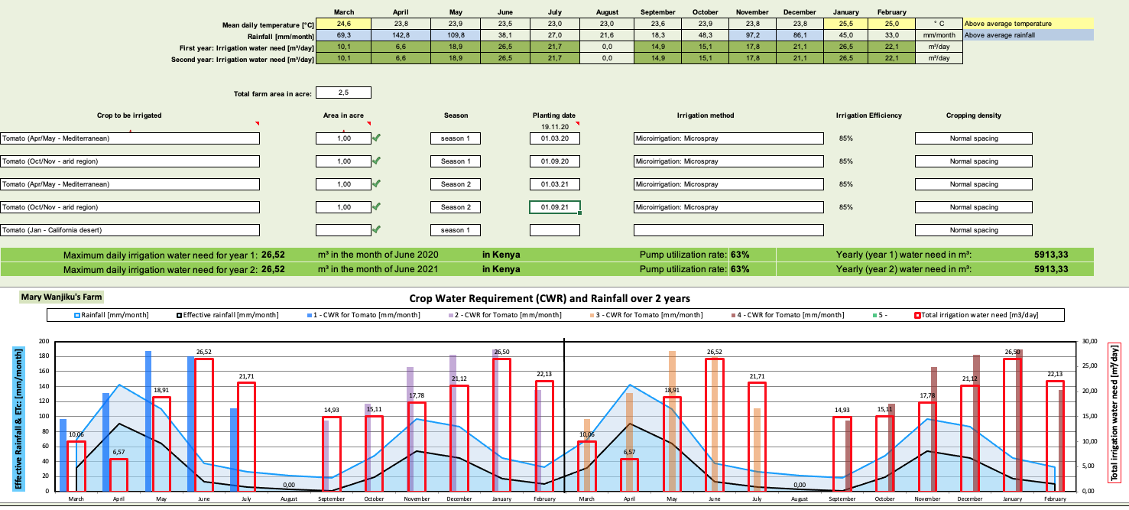
Homework II
Notes:
Prepare the correct Summary sheet of the Water Requirement Tool

Slide 12
Poll 1: What can you say so far about the course?
Understood so far – want to know more
Webinars should be longer to discuss more
Time for webinars and homework is ok for me
Good alternative to face-to-face training
Notes:
Proposal: Multiple choice, 2 options
You may use a poll system depending on the platform you use:
Zoom: Polls are integrated into the platform – you can prepare the questions in advance
MS TEAMS (GIZ version): If MS Teams is provided by GIZ, polls are not available. You must either use a external tool (SliDo) or provide the question as a hand-out (prepare in advance) and ask participants to print, mark their choice and hold it into the camera.
Ask participant s to give their answers in the Chat
Explain poll, show results when the poll is still on and comment the result; give participants the chance to comment on their answers, if they want to

Slide 13
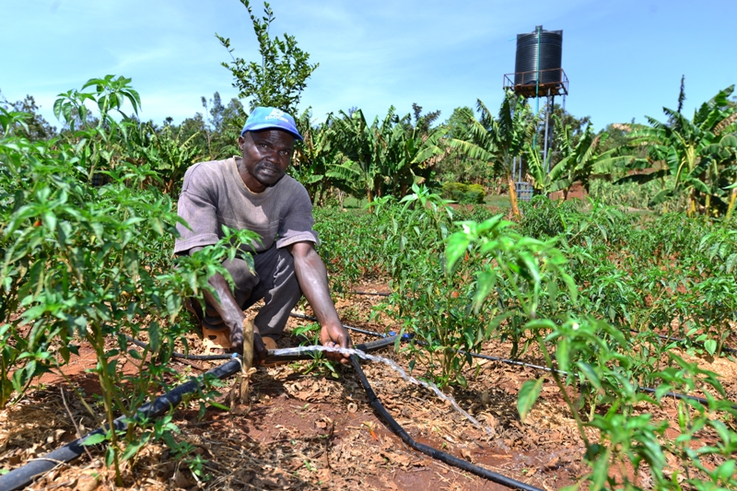

Slide 14
Ice-Breaker
Icebreaker game
Notes:
Refer to the PODIO of the pilot webinars for examples of ice-breaker games

Slide 15
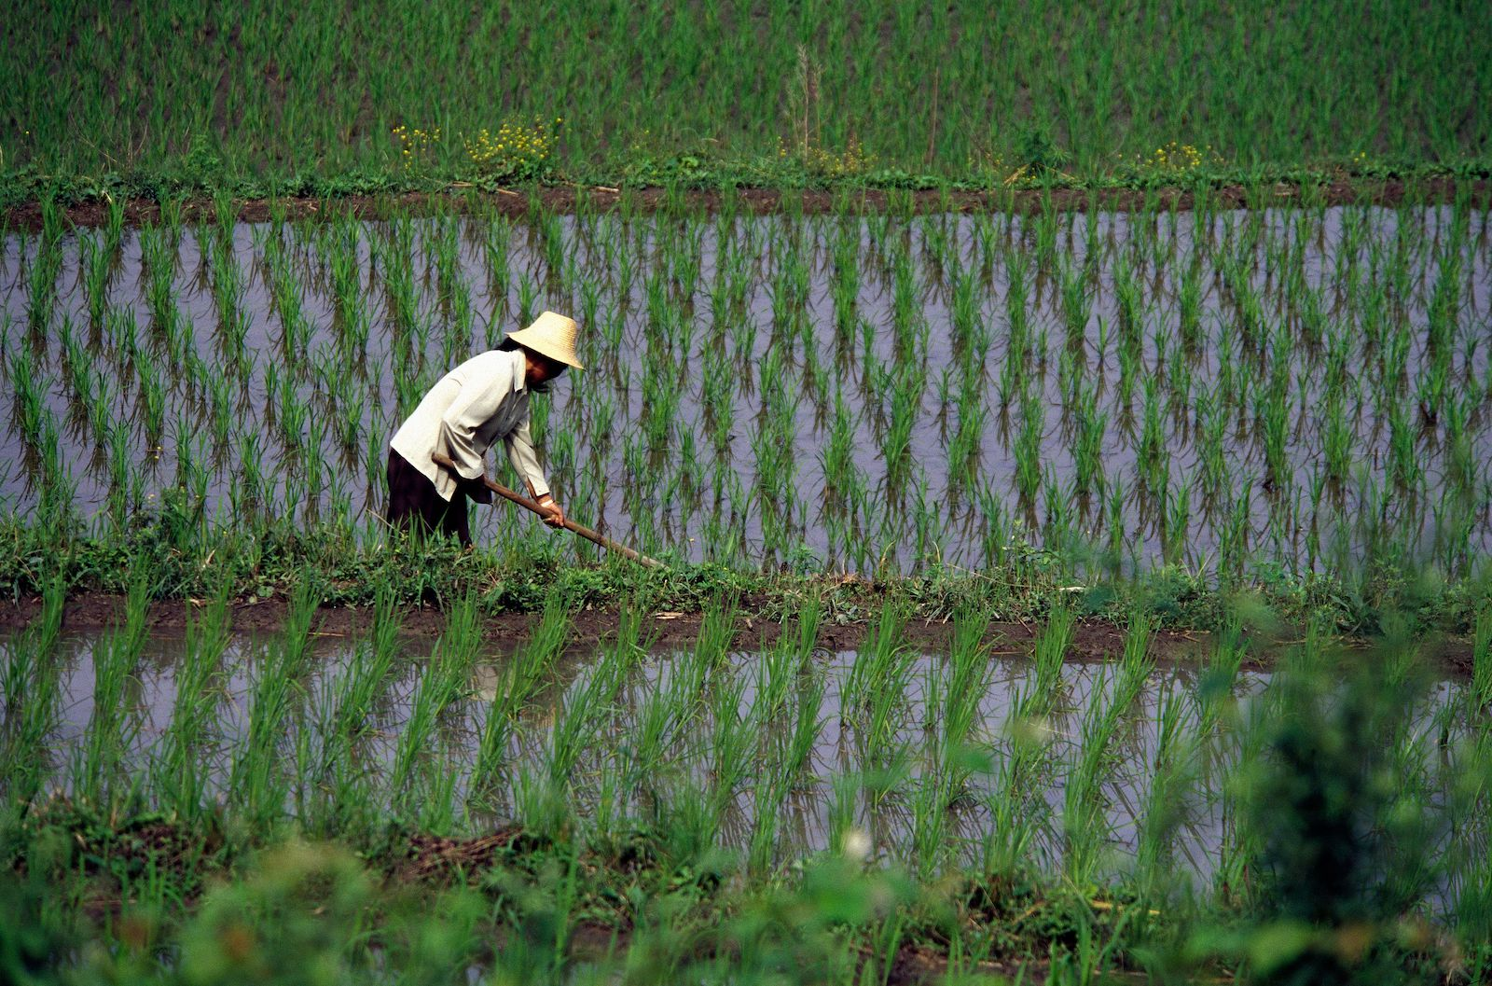

Slide 16
The toolbox – an overview
The «Energypedia toolbox» is the basis for the webinars and we will mainly concentrate on the tools to plan and design SPIS.
Let us look at the toolbox: https://energypedia.info/wiki/Toolbox_on_SPIS
Show the website (link above), go to “Contents of the Toolbox” and then to Design and download the “Pump Sizing Tool” (Handout3.1)

Slide 17
CCC Kenya & Pump Sizing Tool
2 Hand-Outs: 3.1 & 3.2
CCC: The farm of Miss Mary Wanjiku in Kenya
Pump Sizing tool: Excel calculation sheet to calculate pumping head and select pump type, pump size and PV modules for the pump. Data from the water requirement tool are needed as well as from the water source available.
Refer to the screencast
Notes:
Download the tool and click on Read me: the tool has 5 sheets - an overview is given here:
The Head Calculation is quite important and is overlooked in many cases.
You have to fill in basic assumptions
The daily solar irradiation is available at the link on the right (global solar atlas)
You can assume 25% solar system losses
You have to know your estimated water source yield – the sustainable one will be just a fraction of it.
You have therefore to adjust the daily pumping rate
Pump pipeline diameter and length are very important for the head calculation.
Determination of pumping head depends if your irrigation system is direct feed or if you have a tank system.
The different parameters are explained in the drawings
Estimation of pressure requirements for different irrigation methods are given as well as a conversion size for the pipe sizes
The head loss in fittings is given in the „Input Pump Pressure Loss“ and in the irrigation system in „Input irrigation Pressure Loss“
After all data are entered, you will get In the sheet „OUTPUT Results“ the size of your solar pumping system and the estimated solar panel surface.
This tool can also serve to test different configurations, different pipe sizes, etc. to optimize your system.
The sheet Terminology helps for your understanding of the different terms regarding pumps.
Screencast: https://youtu.be/hyEESxjQOZQ

Slide 18
Solar pump basics: Presentation
Hand-Out: 3.3 A or B
Participants Slides (Webinar II)
Alternatively:
Solar Pumps – an introduction by Mohamed (Handout 3.3A)
Solar Pumps – an introduction (Lorentz, Handout 3.3A
Notes:
Participants who have experience with a certain pump could present their system with emphasis on the pump. Different suppliers could be presented.
Another alternative is the handout 3.3 A or B, which show general facts about solar pumps. It must be clearly stated, that Handout 3.3B is from Lorentz company, but we do not favour this manufacturer but only use the slides, which are rather informative and give good information on solar pumps.
Handout 3.3 A has not manufacturer name on it – it is based partly on the pictures by Lorentz but without reference to it and therefore more neutral.
Please study the slides carefully before you use them so that you can answer questions on them.
You might shorten the presentation (handout 3.3) depending on the time available. In case you shorten them, you may also have to omit some test questions.

Slide 19
Videos
Hand-Out: 3.4
Handout 3.4 gives links to
Hands-On-Videos on Centrifugal pumps, helical rotor pumps and positive displacement pumps
a short video on «How Solar Pumps Work» and
a comprehensive guide on irrigation pumps
Please have a look in the coming days at these videos and you will find a lot of practical information on the different pumps that can be used with solar energy.
Notes:
If time allows, show the video on centrifugal pumps, as they are the most used pumps: https://youtu.be/hcnMGDLtb9U

Slide 20
Poll 2: Test question
Static head is…
also known as suction head
the vertical distance between the lowest point of the water source and the highest point of water delivery
always the same for any systems
always less then TDH
Notes:
Multiple result!
You may use polls or use the chat to get participants‘ answers
Explain poll, show results when the poll is still on and comment the result; give participants the chance to comment on their answers, if they want to
Correct Answers: 2 & 4

Slide 21
Poll 3: Test question
Friction losses are affected by...
Length of pipe
Material of pipe used
Diameter of pipe
Pressure of water
Notes:
Multiple result!
You may use polls or use the chat to get participants‘ answers
Explain poll, show results when the poll is still on and comment the result; give participants the chance to comment on their answers, if they want to
Correct Answers: 1, 2 & 3

Slide 22
Poll 4: Test question
Storing water in tanks for overnight use is better than using batteries because...
Battery transport & disposal is difficult
Batteries typically introduce up to 50% inefficiency to the system
No licences are needed for water tanks
Batteries are expensive to install and maintain
Notes:
Multiple result!
You may use polls or use the chat to get participants‘ answers
Explain poll, show results when the poll is still on and comment the result; give participants the chance to comment on their answers, if they want to
Correct Answers: 1, 2 & 4

Slide 23
Homework
2 Hand-Outs: 3.1 & 3.2.
Make yourself familiar with CCC Kenya questions on pump sizing; send filled out sheet «OUTPUT_Results» of the «Pump Sizing Tool» (Data in the tool for demonstration only and do not apply to CCC Kenya)
Refer to the screencast
Please fill in the evaluation in «Google Forms» (add the address here)
Notes:
As you know, the video helps you to fill out the sheets if you encounter problems.
The handouts 3.1 and 3.2 are again the tool itself and the Country Case Card Kenya.
If you want, you can also work in groups – in the ones you stayed earlier on or you select your co-works otherwise.
Prepare in advance the evaluation questions in Google forms. Examples for questions can be:
Name of the Webinar
Name/e-mail (voluntary?)
Skill and responsiveness of the trainer
Did the level of the course meet my knowledge?
What aspects of this course were most useful or valuable?
Course content was relevant for my work
How would you improve this course?
What can be done better next time?

Slide 24
Presentation
Short presentation of a SPIS project by a participant
Notes:
The responsible person for the next webinar would take contact with the participants who want to show their experiences and communicate with them. Emphasis is on the soil tool, but any short practice related presentation re. Solar irrigation would be ok. The short presentations (if any) should be rehearsed in advance to make sure it works well.
As always, if the responsible trainer for this webinar has an own presentation, it might even be better.

Slide 25
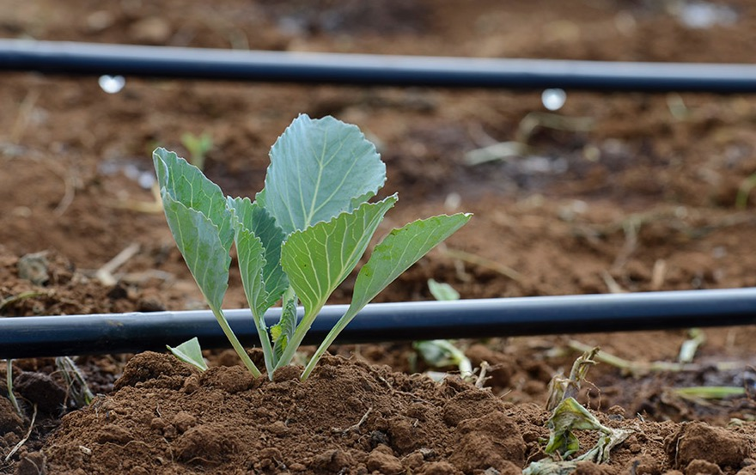

Slide 26
WATER & ENERGY FOR FOOD

