Slide 1





SPIS Training
WEBINAR II – Water Requirement

Slide 2
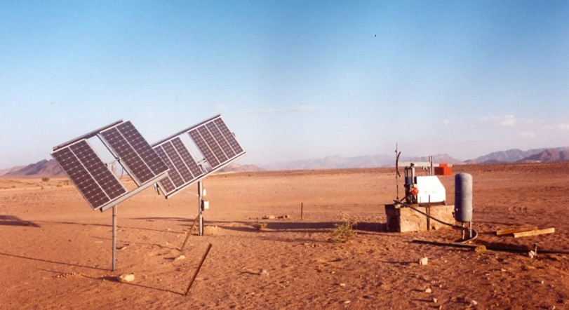
Welcome
to the Webinar Series on SPIS
brought to you by
Water and Energy for Food WE4F
developed by Margraf Publishers on the basis of the «Energypedia Toolbox»
Notes:
Good afternoon and Welcome to our Webinar Series on Solar Powered Irrigation Systems (SPIS) for trainers. It presents the most important tools to design and operate pumping systems and irrigation equipment that utilize solar energy, and to assess whether solar powered irrigation is feasible and applicable in different contexts.
The emphasis is on collaboration between you as participants and between participants and trainers. We will try to make the webinars as lively as possible, although we are aware that a face-to-face workshop is certainly a better solution. Nevertheless, we try to use a lot of collaborative instruments such as polls and working groups, discussion forums, question and answer possibilities, etc.
Naturally, you as participants will be able to widen your background of solar powered small-scale irrigation, which will not come only from the trainers but also from your fellow participants. We will therefore try to involve you as well as presenters in the webinars so that at least some of you will have the opportunity to present specific aspects of your work in SPIS.
A few words on SPIS:
Irrigation is among the measures that can improve yields, reduce vulnerability to changing rainfall patterns, and enable multiple cropping practices. Although expanding, land area under irrigation nevertheless represents a marginal share of total cultivated area, especially in sub-Saharan Africa, where only 5% of farmland is irrigated. Affordable, reliable and environmentally sustainable energy is a vital input for delivering irrigation services.
Solar-powered water technologies are increasingly in demand, as they can provide a cost-effective solution to increase agricultural productivity. Access to water for irrigation is key to many small- scale farmers in order to sustain their livelihoods and food security. Running such irrigation systems is still extremely challenging. In the absence of a reliable electricity supply, farmers often resort to diesel-based pumping systems. These systems create high operating costs, often experience service gaps, contribute to greenhouse gas emissions, and contribute to the energy bill in countries that do not produce such fuels.
Renewable energy options, and in particular solar power, seem a very promising solution for sustainable small- scale agriculture in regions with high solar insulation like Eastern Africa, given its environmental advantages, low maintenance, and decreasing investment costs. However, knowledge of the technology itself, its feasibility, appropriateness and potential for up-scaling is often lacking.
However, we also must be aware that there are also risks with SPIS, especially if we look at the water balance in a watershed and see the risk of groundwater overuse. Therefore, we always have to see the advantages but as well the risks associated – the webinars want to make you aware of the risks as well.
You as participants, we encourage you to actively engage in discussions and contribute with your own experiences and knowledge on solar technology and initiatives in your respective countries. Our experience is that the exchange between you participants of different countries is often the highlight of such webinars.

Slide 3
Introduction to the Webinar-series
In a sequence of six webinars of 1:45 hrs each, you will be familiarised with the use of the most important Excel tools in the SPIS-Toolbox
At the end of the six webinars, you should be able to advise a farmers on the use of SPIS for agricultural irrigation
The training material consists of the agenda and corresponding resources (videos, additional documents, test questions)
Notes:
The webinars are designed for extensionists, policy makers financiers, not so much for end-users (farmers).
Timing:
It is important to make participants aware that you always start 15 min before in order to support them when problems with the webinar software and to (hopefully) solve internet access problems (if possible)
All Webinars will last at the core 105 min and start with an explanation of the respective tool and foresee 15 min at the end for one of the participants to share experiences in SPIS
The agenda will be shown in the next slide – the basic structure will be similar for all the 6 webinars.

Slide 4
Agenda Webinar II – Water Requirement add time and date here
Time | Topic | Remark
23:45 | Room is open | Insert the address here
00:00 | Welcome | Introduction to the topic
00:05 | Today’s objectives | Who is online? Where do the participants stand? Program & Objectives
00:15 | Homework of Webinar I | Solutions and Discussion «Farm Analysis»
00:30 | Poll | Level of homework
00:35 | Group work: SPIS Bingo | Divide into groups and provide links
00:50 | Poll: Level of group work
00:55 | Water Requirement Tool
01:15 | Homework
01:30 | Presentation of a SPIS project | Insert the topic and the name of the participant (s) here (as agreed on during the last webinar)
01:45 | Farewell & Outlook | Evaluation, next presentation
Notes:
Adjust the times, links, presentation names (all what is written in red)
Who is online – After we already received a short introduction last webinar, you can ask the participants perhaps what was important for them since the last webinar; what occupied them, how they feel in general (or similar)
The first point has already been done and we are happy that the Webinar Tool is now understood by all.
We will shortly discuss the home work – we are happy that many of the participants have sent in their results and mostly the correct ones. You should be able to work with the toolbox for future assignments or whatever you can use it for.
The poll will ask about the homework
Today we will engage in group work. We will explain, how group work in the digital space can work. We will start with a SPIS-Bingo. You will soon see what it is about.
The groups will present the results of their work – just as they would have done at a f2f workshop.
Afterwards we will go to the water requirement tool
We will explain the homework which asks questions the water requirement tool can answer. Each webinar will give you a short homework, You will work on one tool (in our case the Water Requirement Tool) in order to understand it and be able to discuss about it in the next Webinar.
We are happy to have the participant...., who will talk to us on.....
Farewell:
Resume the results of the evaluation of webinar and announce the evaluation of Webinar II; Determine a participant who will present next and refer to the Evaluation of this Webinar 2.

Slide 5
General Objectives
Relevant background information on the components of Solar Powered Irrigation Systems and planning their application
Emphasis will be on the use of the most important Excel tools in the SPIS-toolbox
Hands-on guidance to end-users, but also policy makers and financiers
Notes:
Highlight that today we will focus on Water Requirement

Slide 6
Objectives of Webinar II
Participants know components of SPIS (through a BINGO game)
They know the approach of group-work in a virtual environment
They are familiar with polls
Participants are familiar with the Water Requirement Tool
They know how to determine the water requirement of different crops at a certain site

Slide 7
Who is online?
Please tell us very briefly (in not more than 30 sec)
  What was important for you in the last webinar
  What happened since the last meeting
Notes:
Make sure that people do not talk more than 30 sec as we will otherwise run out of time. (Calculate the necessary time – possibly adapt the agenda)
You may also ask the participants who could not say a sentence about themselves last time.
Maybe the trainer starts with talking him/herself – this will set the scene and participants have a short guideline of how to do it.

Slide 8
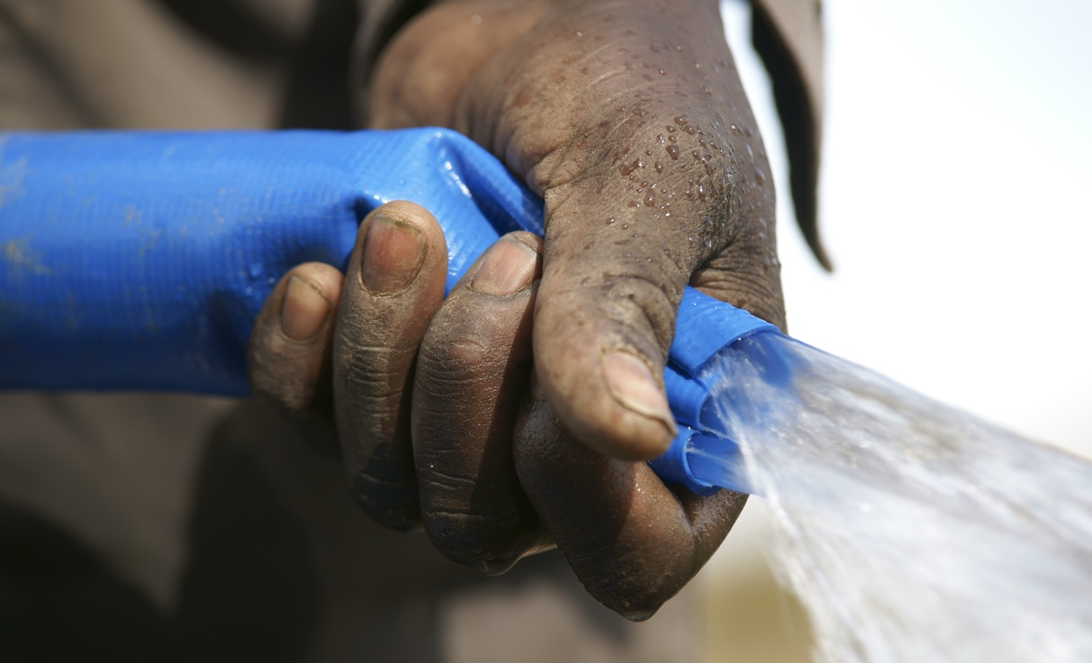

Slide 9
Homework I
What is the farm’s gross income? KES
What is the farm’s total expense? KES
What is the farm’s total variable cost? KES
What is the farm’s gross profit? KES
What is the highest variable cost? @ KES
Notes:
Ask for the answers of each line and give the right one. The figures should come from the sheet 6 of the Farm Analysis tool
...discuss the common mistakes and show the correct process of filling in data, etc. depending on the mistakes
What is the farm’s gross income? KES 855.000
What is the farm’s total expense? KES 601.230
What is the farm’s total variable cost? KES 253.450
What is the farm’s gross profit? KES 253.770
What is the highest variable cost? Salary costs (temporary staff)
@ KES 180.000

Slide 10
Homework I – Solution
What is the farm’s gross income? KES 855.000
What is the farm’s total expense? KES 601.230
What is the farm’s total variable cost? KES 253.450
What is the farm’s gross profit? KES 253.770
What is the highest variable cost? Salary costs (temporary staff)
@ KES 180.000
Notes:
Show the whole solutions here
...discuss the common mistakes and show the correct process of filling in data, etc. depending on the mistakes

Slide 11
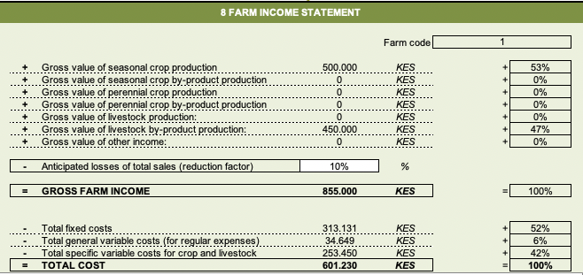
Homework I
Notes:
Prepare the correct Summary sheet of the Farm Analysis Toolbox (be aware that the data for the 2 farm workers have been slightly changed so that the solutions which are presented in the toolbox (Training) are not identical with the ones for the course.

Slide 12
Poll 1: How was the homework?
Too easy for me
Difficult for me
I did not understand how to fill in the data in the Excel sheet
Exactly right
Notes:
Proposal: Single choice
You may use a poll system depending on the platform you use:
Zoom: Polls are integrated into the platform – you can prepare the questions in advance
MS TEAMS (GIZ version): If MS Teams is provided by GIZ, polls are not available. You must either use a external tool (SliDo) or provide the question as a hand-out (prepare in advance) and ask participants to print, mark their choice and hold it into the camera.
Ask participant s to give their answers in the Chat
Explain poll, show results when the poll is still on and comment the result; give participants the chance to comment on their answers, if they want to

Slide 13
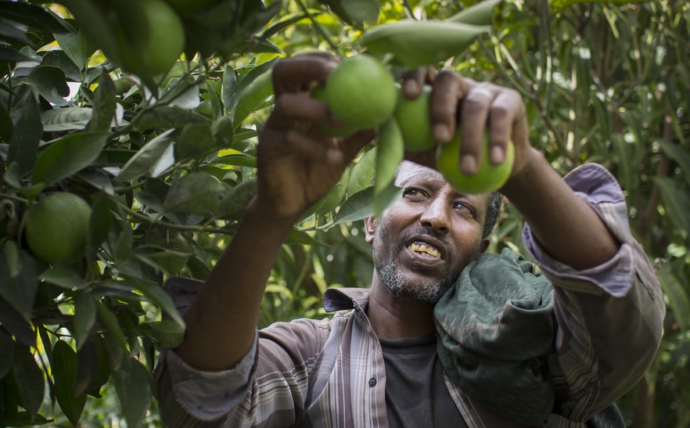

Slide 14
The «Concept-Board»
Address Group 1:
Address Group 2:
Address Group 3:
Address Group 4:
Notes:
Explain how group work could be depending on your choice:
Conceptboard: Conceptboard is integrated into MS Teams. Prepare the different groups (Bingo) in advance and implement into MS Teams-group.
The conceptboard must be licenced – Licence information by GIZ
Working groups: Refer to the video (Podio – Pilot Webinar 5 How to use Breakout Rooms in Microsoft Teams)
There are several possibilities:
You can give each group some pictures (from Handout 2.3) and they have to find the correct term.
You prepare the conceptboard (example in the next but one slide) with the pictures and terms and participants move the correct term into the picture
If group work would get too difficult, you can show one picture (from Handout 2.3) after the other and participants have to name one of the terms that fits

Slide 15
Group Work Tasks
2 Hand-Outs: 2.3 and 2.4
In the handout 2.3 you will find 24 pictures of SPIS components.
Please match the components mentioned in the handout 2.4 with the pictures.
Make a table with the picture number and the corresponding component name.
Notes:
Handout 2.3. shows 24 pictures connected to SPIS. Handout 2.4 shows the terms which have to be used in the Bingo
Demonstrate how it works in the next slides.

Slide 16
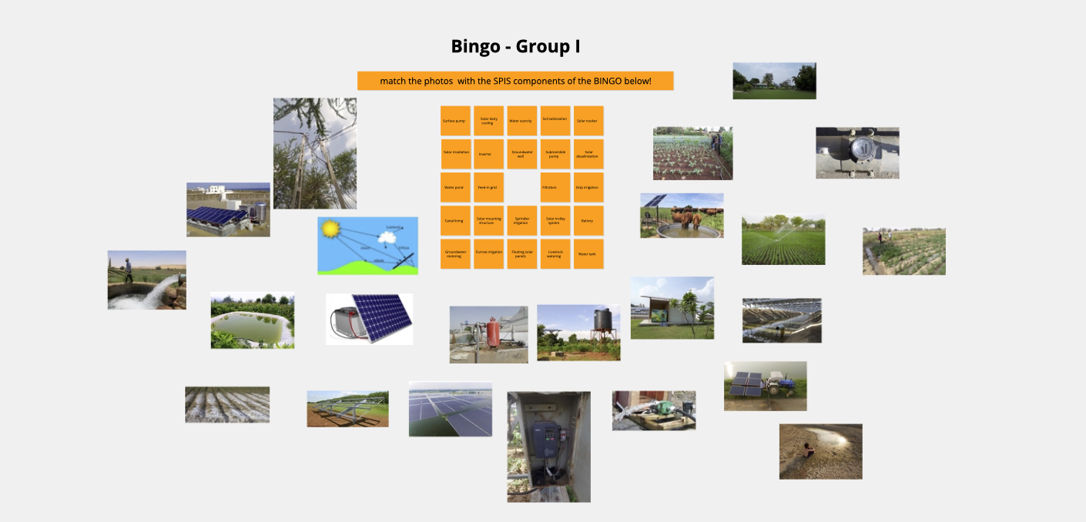
The «Concept-Board»
Hand-Outs: Bingo Images
Notes:
When using MS Teams: Conceptboard is integrated into MS Teams. Prepare the different groups (Bingo) in advance and implement into MS Teams-group.
The conceptboard must be licenced – Licence information by GIZ

Slide 17
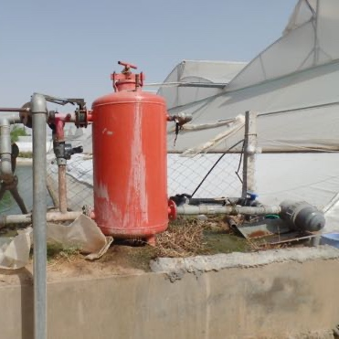
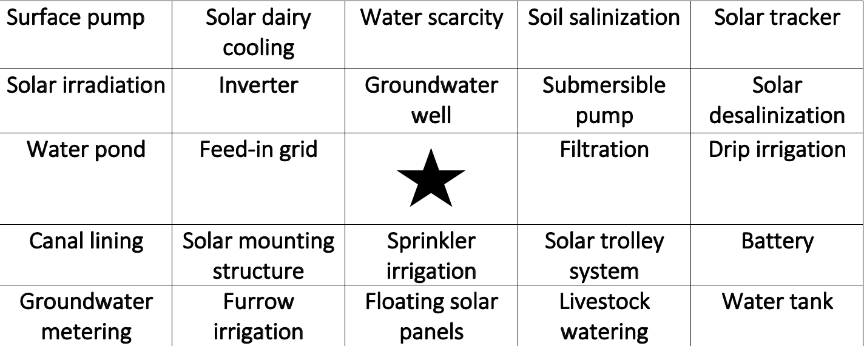
Terms for Bingo…
Hand-Out: 2.4
Notes:
You will find the handout 2.3 Photos for the SPIS Bingo with pictures like the one here and there is the handout 2.4 with the different terms that match with the pictures.
The task is to match each picture with one of the terms in the Bingo sheet (Handout 2.4). The result will be a table as indicated on the next slide

Slide 18
Expected result…
Pictures | Related terms
1 | ?
2 | ?
3 | ?
4 | ?
5 | ?
6 | ?
Notes:
You look at picture one of handout 2.3 and find the suitable term for it. Your table will go up to 24, we have only put 6 here to make the task clearer. I hope this is understood by now?

Slide 19
Presentation
Every group decides on whom to present the results in advance
You have 10 min to work in groups
Notes:
Ask which group wants to present. Make sure that their file can be shown and one of them gets the right to talk (microphone unmuted) and the right to share monitors

Slide 20
Poll 2: How was the BINGO?
Too easy for me
Difficult for me
We first had to get to know the other group members before we could start the tasks
Exactly right
Notes:
Proposal: Single choice
You may use a poll system depending on the platform you use:
Zoom: Polls are integrated into the platform – you can prepare the questions in advance
MS TEAMS (GIZ version): If MSTeams is provided by GIZ, pollsare not available. You must either use a external tool (SliDo) or provide the question as a hand-out (prepare in advance) and ask participants to print, mark their choice and hold it into the camera.
Ask participant s to give their answers in the Chat
Explain poll, show results when the poll is still on and comment the result; give participants the chance to comment on their answers, if they want to.
Participants can raise their hands or write into the chat – depending on the webinar software used.

Slide 21
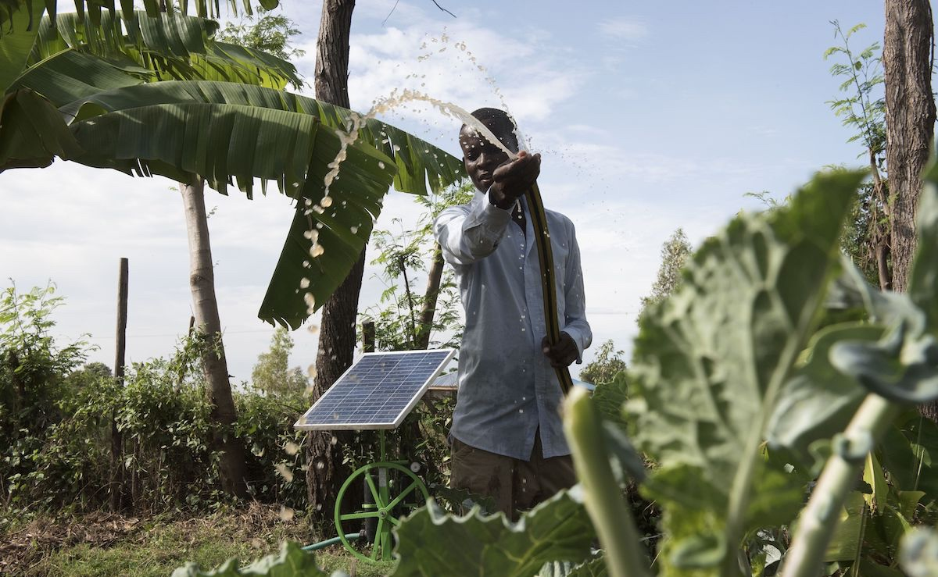

Slide 22
The toolbox – an overview
The «Energypedia toolbox» is the basis for the webinars and we will mainly concentrate on the tools to plan and design SPIS.
Let us look at the toolbox:
https://energypedia.info/wiki/Toolbox_on_SPIS
Show the website (link above), go to “Contents of the Toolbox” and then to Safeguard Water and download the “Water Requirement Tool” (Handout2.1)
Notes:
Show the start page
Today we want to look at the module „Safeguard Water“ and the Water Requirement Tool. It is also available as Handout2.1

Slide 23
CCC Kenya & Water Requirement tool
2 Hand-Outs: 2.1 & 2.2
CCC: The farm of Miss Mary Wanjiku in Kenya
Water requirement tool: Basic water requirement calculation tools for crops and livestock
Refer to the screencast
Notes:
Show Handout 2.1_Water_Requirement_Tool (the data in the tool are only to show how to fill them in – they do not apply to the CCC Kenya) –
Go through the different sheets yourself and/or use the screencast: https://youtu.be/nM--P4Td-C8
You can always interrupt and ask questions or give comments

Slide 24
Homework
2 Hand-Outs: 2.1 & 2.2.
Make yourself familiar with CCC Kenya questions on water requirement
Send filled-out sheet (2: Crop Water Requirement) of the «Water Requirement Tool» with two growing periods and micro sprinkler irrigation as PDF and send it by mail to your trainer (present it in the next webinar)
Refer to the screencast
Please fill in the evaluation in «Google Forms»
(add the address here)
Notes:
As for the homework in the last webinar, all participants should send in sheet 2, Crop Water Requirement of the „Water Requirement tool“ → you have to give them an e-mail address!
The video (screencast) helps you to fill out the sheets if you encounter problems.
The handout 2.1 is the water requirement tool and Handout 2.2 is again the Country Case Card Kenya and the question in red is the one to be answered.
If you want, you can also work in groups – in the ones you stayed earlier on or you select your co-works otherwise.
Prepare in advance the evaluation questions in Google forms. Examples for questions can be:
Name of the Webinar
Name/e-mail (voluntary?)
Skill and responsiveness of the trainer
Did the level of the course meet my knowledge?
What aspects of this course were most useful or valuable?
Course content was relevant for my work
How would you improve this course?
What can be done better next time?

Slide 25
Presentation
Short presentation of a SPIS project
by a participant
Can anybody share next webinar his of her experience with a particular solar pump?
If so, please send 2-3 photos or slides latest on the weekend to address here
Notes:
The responsible person for the next webinar would take contact with the participants who want to show their experiences and communicate with them.
Emphasis is on (different) pumps and the experience around it.
The short presentations (if any) should be rehearsed in advance to make sure it works well.
Otherwise there is a handout (slides) that can be used.
If the trainer has an own presentation this might even be better!

Slide 26
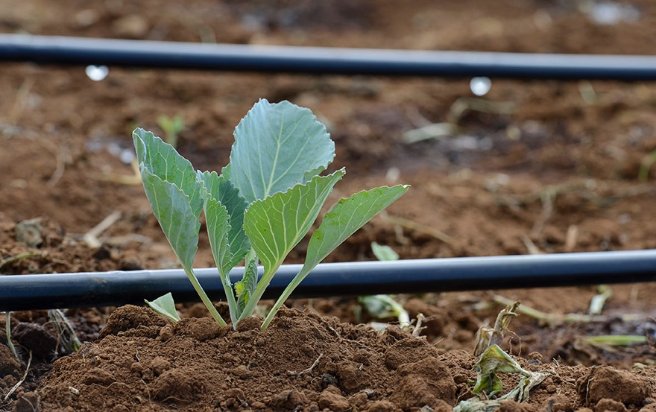

Slide 27
WATER & ENERGY FOR FOOD

